Slide 1
CSCI369 Lab 1 Question 7

Slide 2

We are Lim Yan Zhen Grace, Kyle Sore, Ong Chuan Jie Sean, Damian Yeo Kun Han.
T08

Slide 3
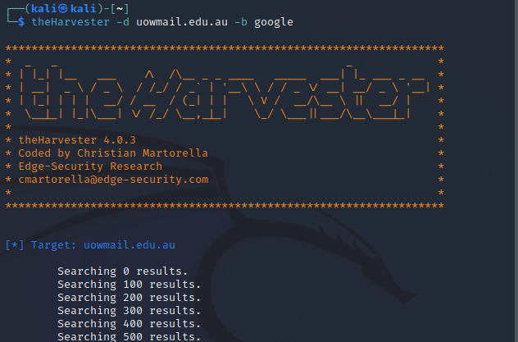
Results
theHarvester is a command-line tool in Kali Linux that uses a variety of Search Engines to find:
Email Accounts
Subdomain Names
Virtual Hosts etc.
Explanation of Process:
-d argument requests the target domain for the search.
-b argument requests the search engine to use.

Slide 4
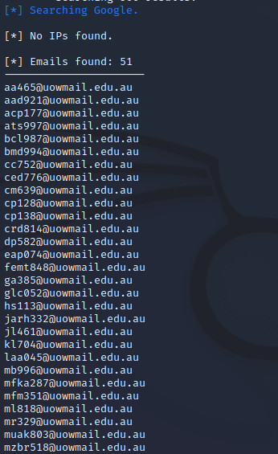
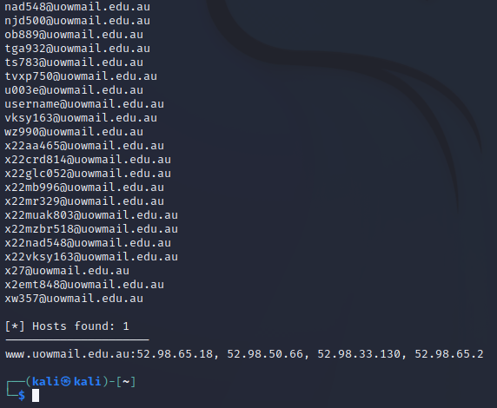
Results

Slide 5
Thanks!

